Slide 1


Open Source IC Design Tools Workshop Day-1 Introduction and Overview
Prof. Dr. Rashad M.Ramzan
Engr. Shahid jamil
National University of Computer and Emerging Sciences (FAST-NU),
A.K. Brohi Road, H-11/4,
Islamabad-44000, Pakistan

Slide 2
Outline of Presentation
Introduction
CMOS Fabrication Process
Open-MPW
Open-Source Tools

Slide 3
Introduction

Slide 4
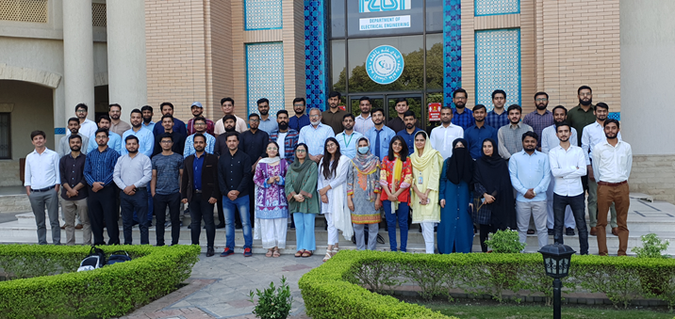
RFCS² & ICD Lab
First MS IC Design Program in Pakistan
Cadence Tool Suite and Multiple PDKs
44 Graduate Students, majority is on Fellowships
Unique program for Hands on Concept to Silicon experience for every student.
In 2020-21
02 Tapeouts in 65nm CMOS from TSMC
03 Tapeouts in SkyWater130 through IEEE PICO.
Six Impact Factor Journal and nine Conference Papers
25 IC Design related Seminars and Talks for Student Training

Slide 5
Open Source Workshop Team
Prof. Rashad M Ramzan
B.E UET Lahore Pakistan
M.S. Royal Institute of Technology Stockholm, Sweden
M.S Thesis, Fraunhofer Institute of Electronics, Germany
Ph.D. Linkoping University, Sweden.
Professor Dept. of Electrical Engineering (EE), FAST, NUCES, Islamabad.
Dr. Hassan Saif
B.E, UET, Lahore, Pakistan
M.S & Ph.D. Sungkyunkwan University, South Korea.
Asst. Prof., Dept. of EE FAST, NUCES, ISB.
Engr. Hamza Atiq (MS EE)
Lab Engr. (IC Design ), Dept. of EE FAST, NUCES, ISB.
Engr Shahid Jameel (MS EE)
Analog IC Design Engineer, NECOP Pakistan
Engr M Usman (MS EE)
Digital IC Design Engineer, NECOP Pakistan
Engr Jaffar Hussain (MS EE)
Analog IC Design Engineer, NECOP Pakistan
Engr M Shoaib (MS EE)
Digital IC Design Engineer, NECOP Pakistan

Slide 6
IC Design Lab (ICD) Tapeouts
Licensed Cadence Tool Suite
TSMC 28nm & 65 nm CMOS Process
8 projects on two ICs (4 on each IC)
Kamal-1
Kamal-2
Each IC Dimension: 1 mm x 1 mm
3 projects accepted in IEEE SSCS PICO Design Contest
Open Source Tools
130 nm SkyWater PDK

Slide 7
2021 PICO Tapeout: 3 Projects
2.92 mm
BDA
The SkyWater Open Source SKY130 PDK
Actually its 150nm Technology
WPT
Sub-6 GHz Bidirectional Amplifier:
Application: sub-6 GHz RF front ends
Tools: Xschem, Ngspice, Magic, Netgen.
Backscattering Integration in WPT:
Application: Wireless Power Transfer
Tools: Xschem, Ngspice, Magic, Netgen, ADS( For Inductor Modelling)
64-bit MA Unit:
Application: ALUs
Tools: RTL Vivado, Cadence Genus and Innovus
3.52 mm
MA Unit

Slide 8
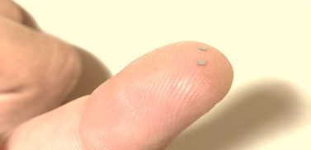
2021 Kamal-1: 4 Projects
TSMC
65nm CMOS
Fault-Tolerant CLB:
Application: Radiation-hard space electronics
Cadence RTL Process
Approximate ALU:
Application: Image Processing
Cadence RTL Process for Design
Hardware TRNG:
Application: Cryptography and 5G systems
Analog Blocks Design: Cadence ADE, Digital Filters Design : Cadence RTL
mmwave LNA:
Application: 5G systems
28-32 GHZ
Analog Blocks Design: Cadence ADE
RF Modeling: RF Pro in Cadence Virtuoso

Slide 9
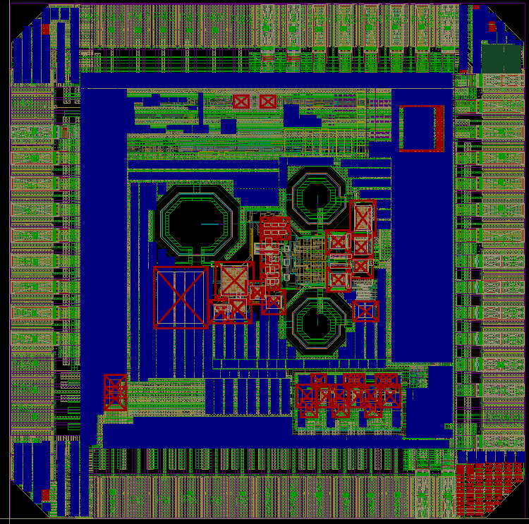
2022 Kamal-2: 4 Projects
1 mm
TSMC
65nm CMOS
TENG
TENG Harvester:
Application: Nano Energy Harvesting
Cadence ADE Design & Implementation
AC Logic Family:
Application: IoT Smart Dust
Cadence ADE Design & Implementation
ΣΔ ADC:
Application: Massive MIMO
MATLAB Modeling
Cadence ADE Implementation & Verification
mm-Wave Phase Shifter:
Application: Massive MIMO
Analog Blocks Design: Cadence ADE
RF Modeling: RF Pro in Cadence Virtuoso
1 mm
Phase Shifter
AC
ΣΔ
Logic
ADC

Slide 10
CMOS Fabrication Process {A Know How about Transistor}

Slide 11
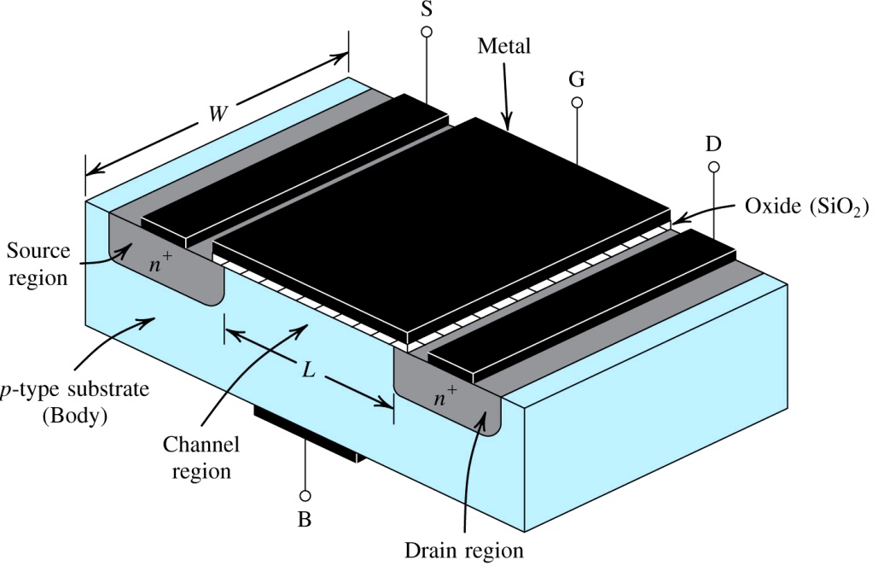
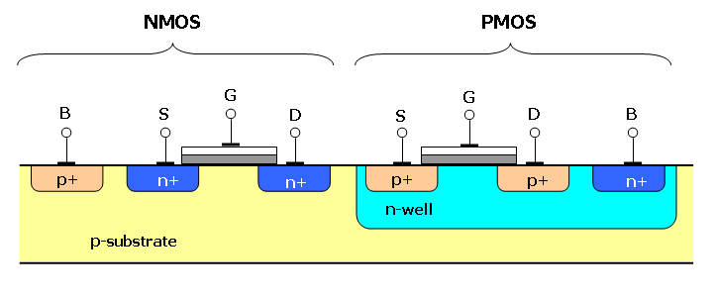
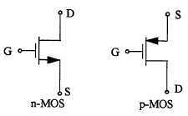
Architecture of CMOS Transistor
Four Terminals:
Drain (D), Gate (G), Body (B), and source (S).
Body and Source are Connected. To ensure that the body diodes are always Reverse Biased.

Slide 12
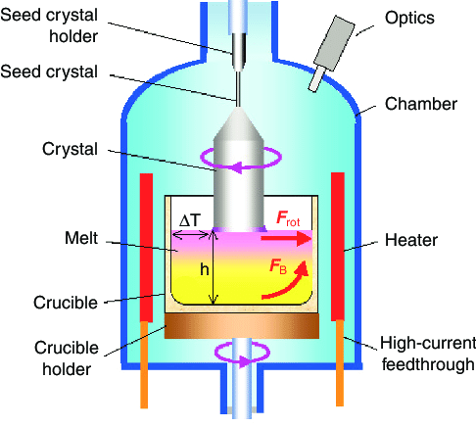
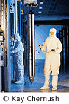
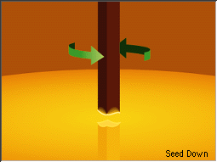
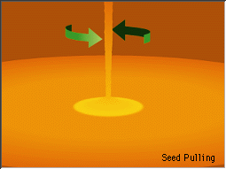
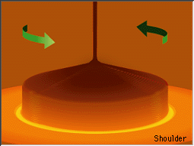
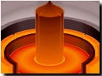
A Single Crystal Si Growth
Czochralski Process
Melt silicon at 1425 °C
Add impurities (dopants) to make n or p type
Dip the seed down
Spin and pull crystal
Slice into wafers
Typical 400 µm to 600 µm thickness.
Polish one side for epitaxi
A finished 120 Kg Si Single Crystal

Slide 13
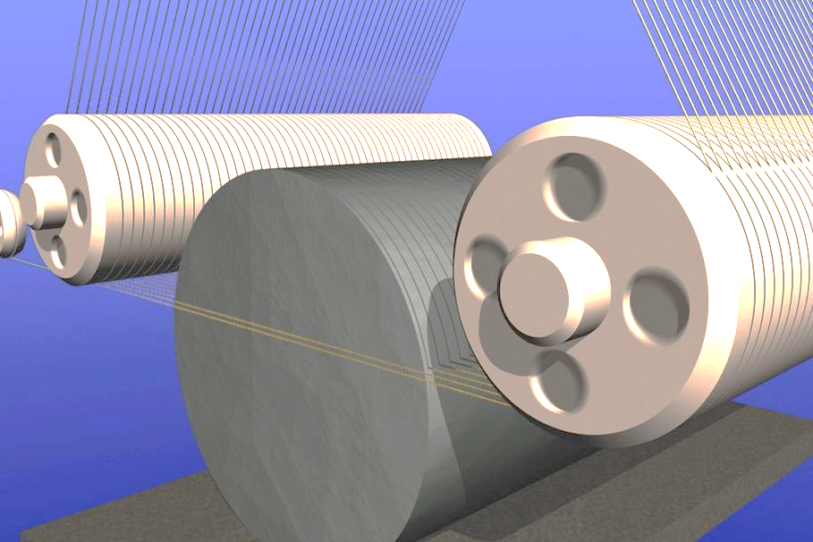
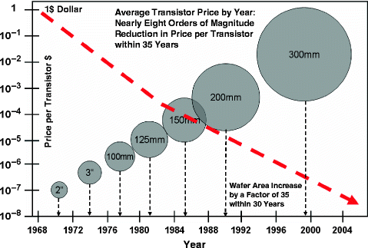
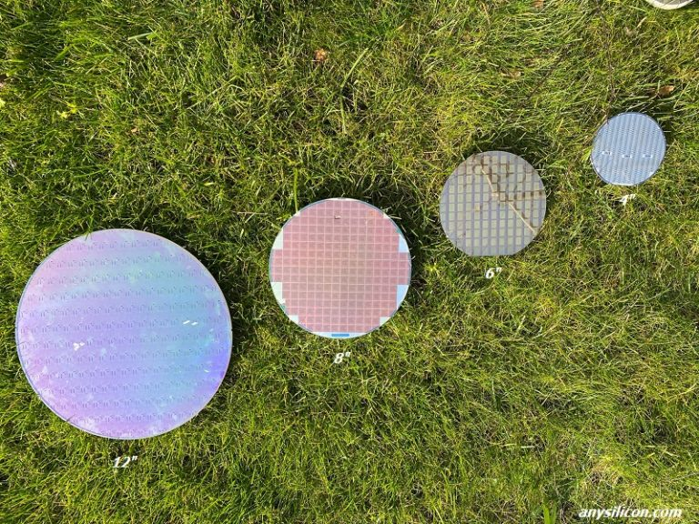
Silicon Wafer
Silicon Ingots are sliced into thin wafers.
Typical Wafer of 400 µm to 600 µm thickness and up to 300mm is diameter

Slide 14
Fabrication Steps
Start with blank wafer
Build inverter from the bottom up
First step will be to form the n-well
Cover wafer with protective layer of SiO₂ (oxide)
Remove layer where n-well should be built
Implant or diffuse n dopants into exposed wafer
Strip off SiO₂
p substrate

Slide 15
Oxidation
Grow SiO₂ on top of Si wafer
900 – 1200 ⁰C with H₂O or O₂ in Oxidation Furnace
Dry and Wet Oxidation.
p substrate

Slide 16
Photoresist
Spin on photoresist
Photoresist is a light-sensitive organic polymer
Originally insoluble, but softens where exposed to light (Positive)
Originally soluble, but hardens where exposed to light (Negative)
p substrate

Slide 17
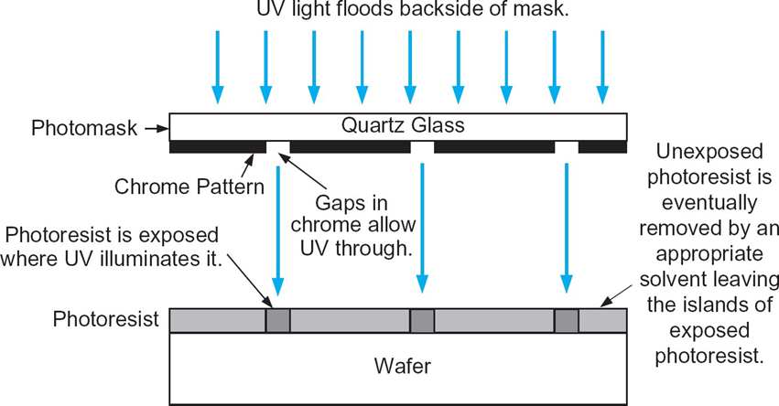

Photolithography
Expose photoresist through photomask
Hardens where exposed to light
Dissolve off unexposed photoresist
Example is Negative
p substrate

Slide 18

Etching (Removal of Oxide)
Etch oxide with hydrofluoric acid (HF)
Seeps through skin and eats bone.
Only attacks oxide where resist has been exposed
p substrate

Slide 19

Strip Photoresist
Strip off remaining photoresist
Use mixture of acids called Piranha etch
p substrate

Slide 20
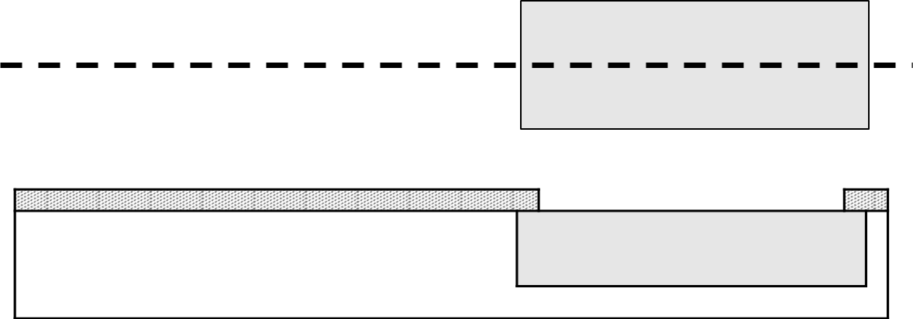
N-well Diffusion or Implant
n-well is formed with diffusion or ion implantation
Diffusion
Place wafer in furnace with P or B called dopant to make N or P type
Heat until dopant atoms diffuse into exposed Si
Ion Implantation
Blast wafer with beam of dopant ions
Ions blocked by SiO₂, only enter exposed Si where mask was
n-well
p substrate

Slide 21
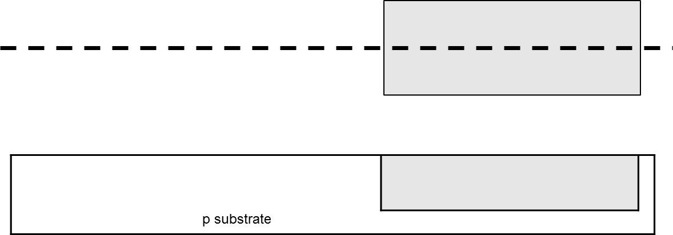
Strip Oxide
Strip off the remaining Oxide using HF
Back to bare wafer with n-well
Subsequent steps involve similar series of steps again and again

Slide 22
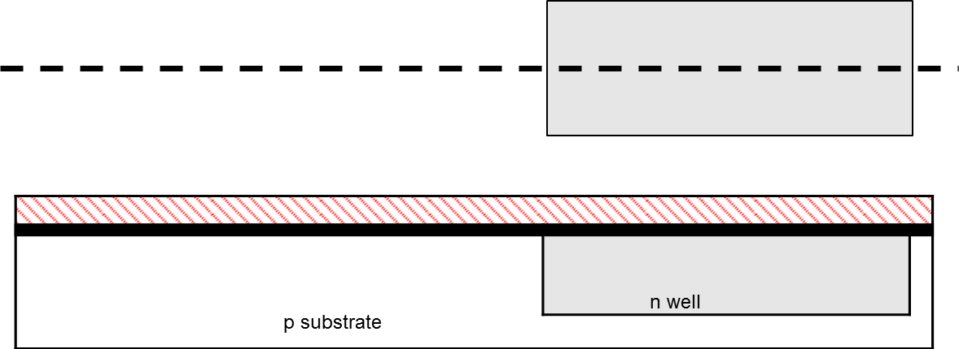
Polysilicon
Deposit very thin layer of gate oxide
< 20 Å (6-7 atomic layers) (For 65nm 1.5nm or 15 Å) -- Dry Oxidation
Chemical Vapor Deposition (CVD) of silicon layer
Place wafer in furnace with Silane gas (SiH₄)
Forms many small crystals called Polysilicon
Heavily doped to be good conductor

Slide 23
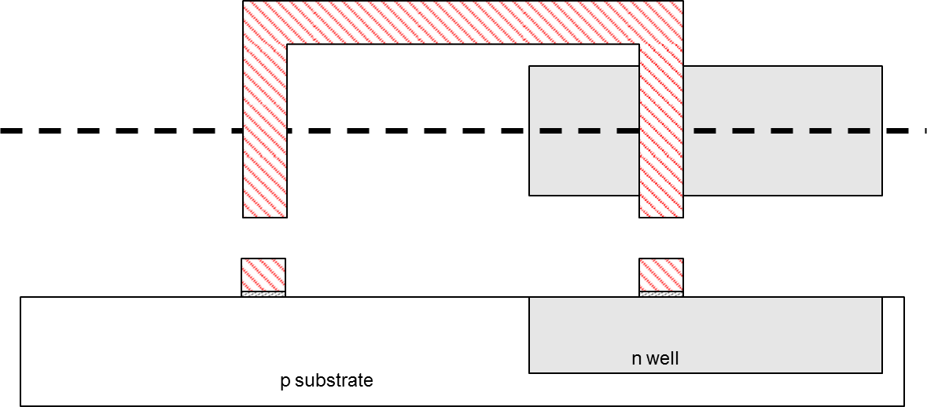
Polysilicon Patterning
Use same lithography process to pattern polysilicon

Slide 24
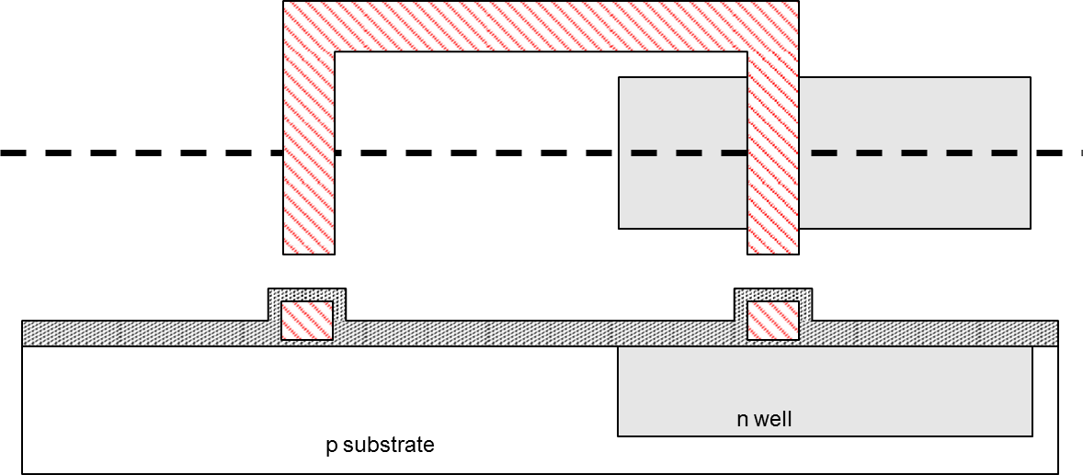
N-diffusion
Use oxide and masking to expose where n+ dopants should be diffused or implanted
N-diffusion forms NMOS source, drain, and n-well contact

Slide 25
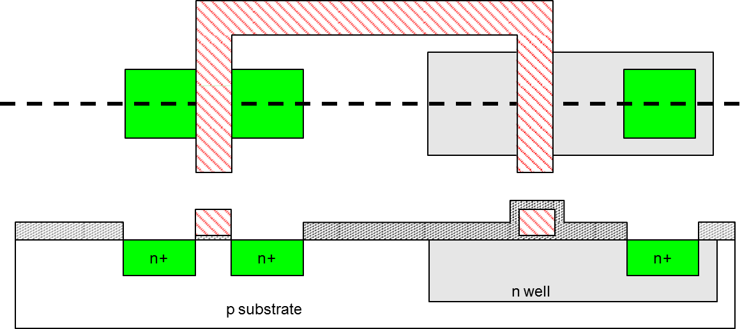
N-diffusion
Pattern oxide and form n+ regions

Slide 26
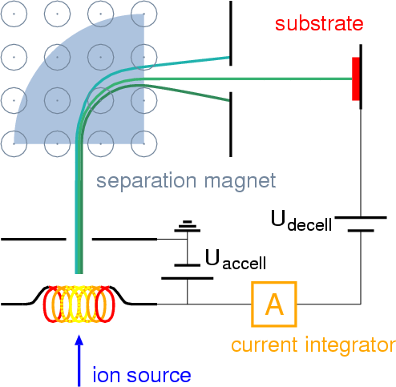
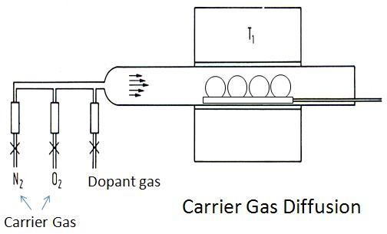
N-diffusion (By Ion Implatation)
Historically dopants were Diffused
Usually Ion Implantation in nm CMOS technologies
But regions are still called diffusion
Doping by Diffusion
Doping by Ion Implantation

Slide 27
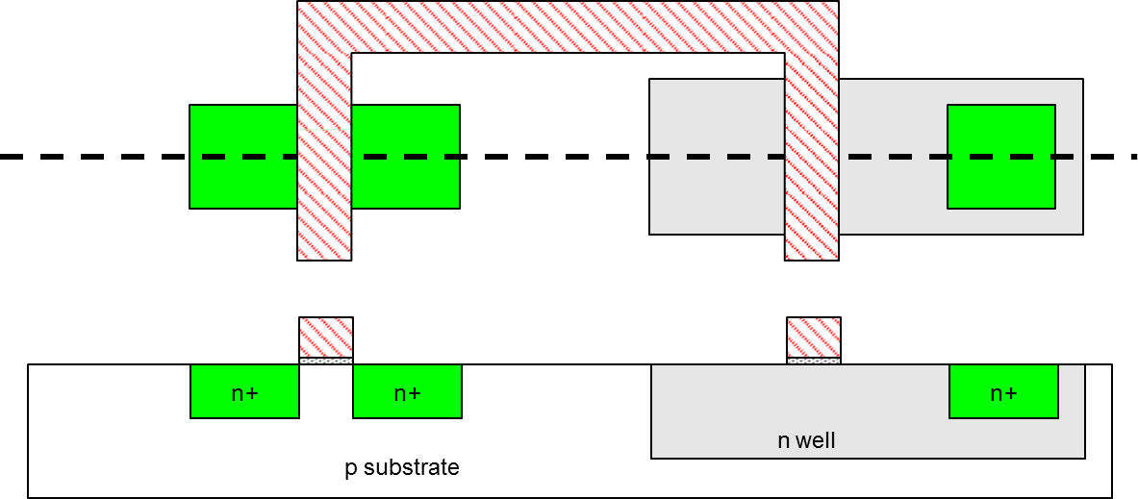
N-diffusion
Strip off oxide to complete patterning step

Slide 28
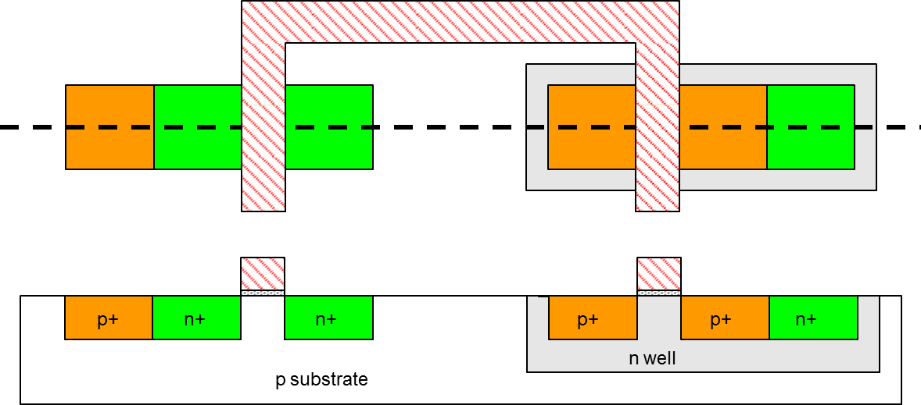
P-diffusion
Similar set of steps form p-diffusion regions for PMOS Source and Drain and Substrate Contact

Slide 29
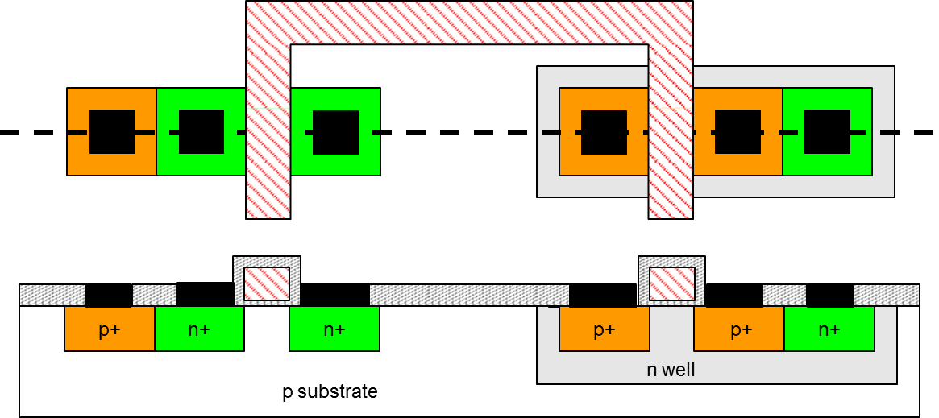
Metal Contacts
Need to wire together the devices
Cover chip with thick oxide
Etch oxide where contact cuts are needed

Slide 30
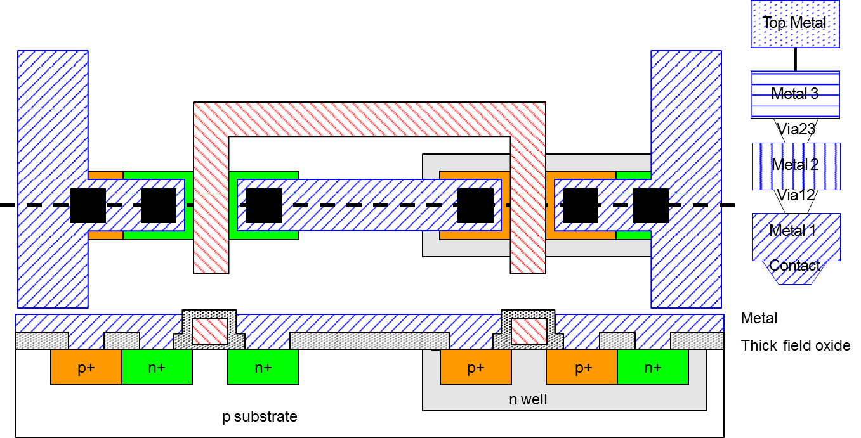
Metallization
Sputter on aluminum over whole wafer
Pattern to remove excess metal, leaving wires

Slide 31
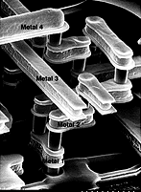
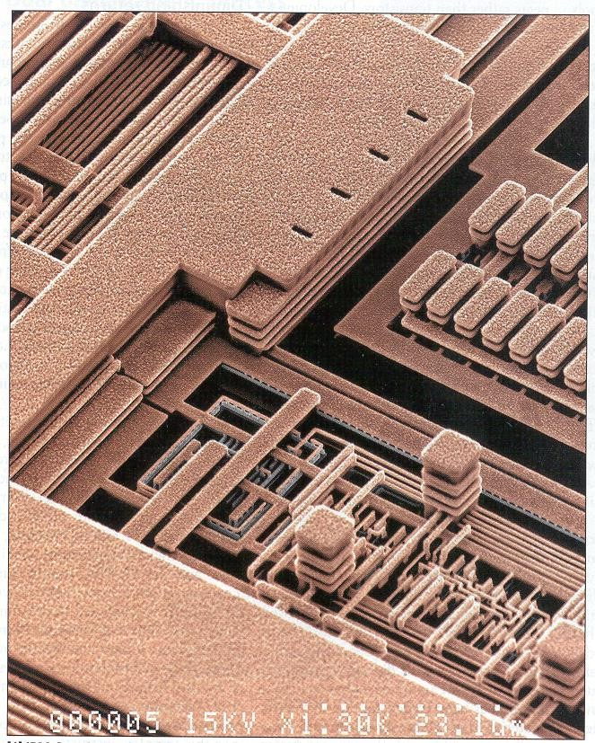
Advance Metallization

Slide 32
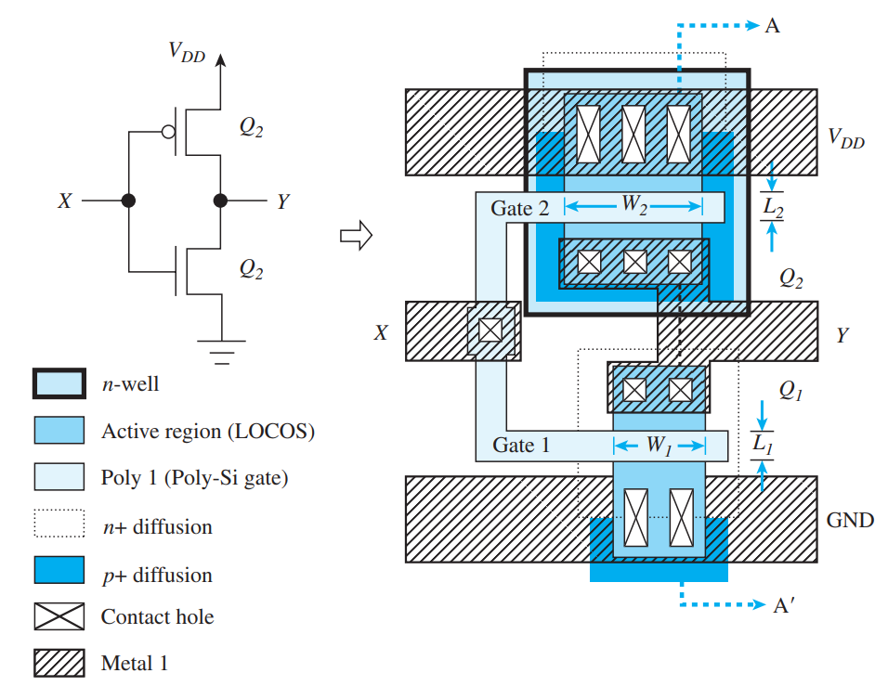
VLSI Layout: Inverter Schematic & Layout
Each process is made up of a specific set of masking layers.
CMOS are defined by the active areas overlapped by the “poly 1” layer.
The PMOS is enclosed in an n-well and PMOS in p-well respectively
Poly-Si gates is used connect to form the input terminal, X.

Slide 33
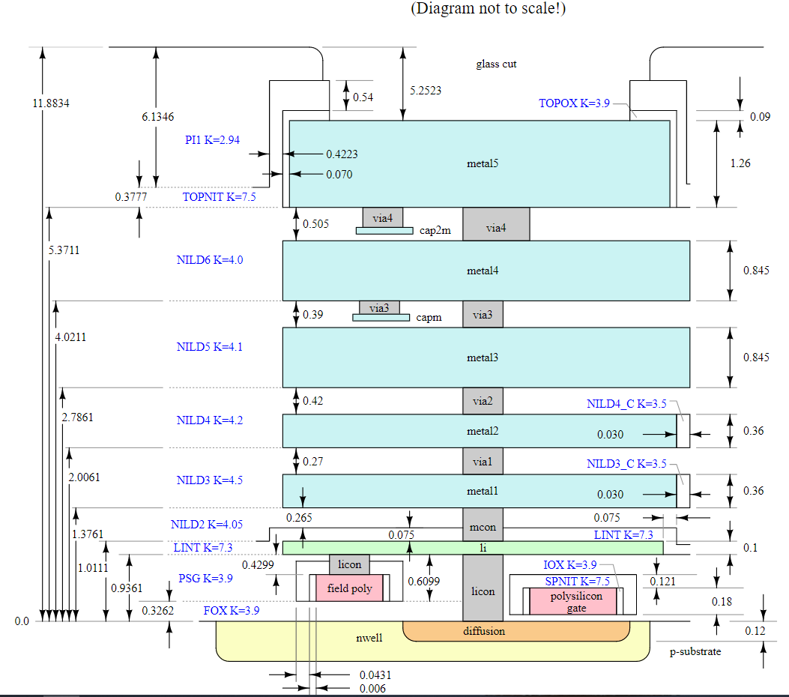
Skywater 130nm Layer Stackup
Internal 1.8V with 5.0 V
I/Os (operable at 2.5V)
1 level of local interconnect
5 levels of metal
Inductor-capable
Has high sheet rho poly resistor
Optional MiM capacitors
Supports 10V regulated supply
HV extended-drain NMOS and PMOS

Slide 34
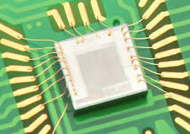
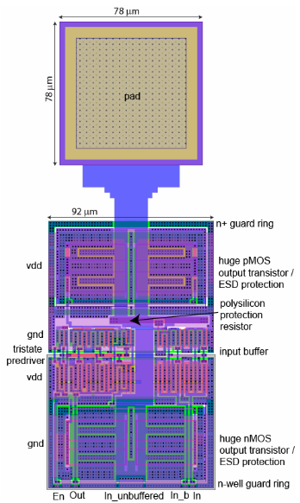
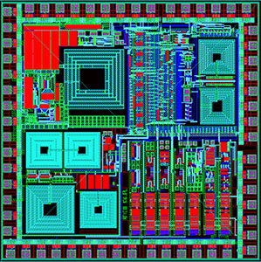
IOs and Pad Frame in a Microchip
Bare Die/ Chip
& Chip Pads for Bond Wiring
on
PCB Tracks
Pad Frame
Individual Pads

Slide 35
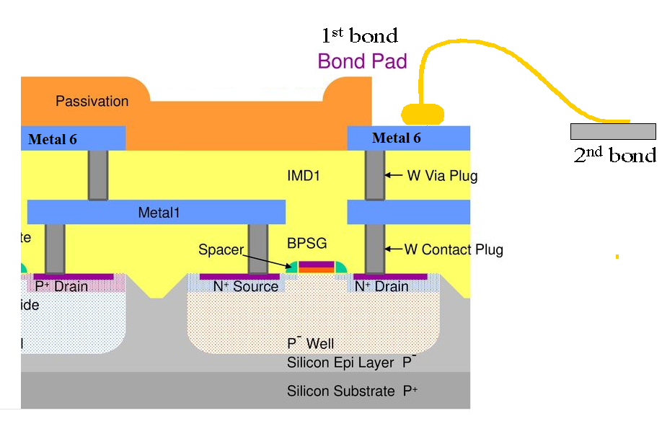
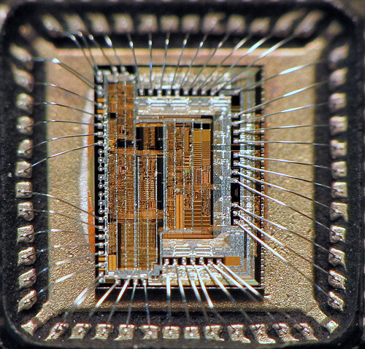
Passivation, Pad Opening and Connection to External Package
Deposit Passivation Layer: There are many types of passivation (silicon nitride, silicon oxynitride, polyimide, etc.
Purpose is to protect the completed circuit from scratches, contamination, and moisture.
The opening in the passive layer is created only at the Bond Pads.

Slide 36
Open-MPW (Engr. Shahid Jamil)

Slide 37
What is MPW
MPW stands for Multi-Project Wafer.
A single silicon wafer is quite large in terms of area with typical diameter of about 16 inches and is also quite costly.
Educational and R&D projects usually don’t need such a large area and don’t have funds for whole wafers.
MPW process basically allocates a small area of the wafer to one project and similarly the whole wafer is distributed among multiple projects. This decrease the cost.

Slide 38
What is MPW
Even in MPW there are minimum area requirements.
The cost is still quite high i-e in thousands of dollars.
This high cost keeps IC designing away from students and research institutes.
This was the case until open-MPW was introduced.

Slide 39
What is Open-MPW
Open-MPW is basically the same MPW process but the cost is completely funded by the google.
Google has partnered with Skywater foundry to bring its CMOS 130nm process design kit to open-source community.
Previously the PDKs were provided under NDA and were highly classified material.
The emergence of an open-source PDK and a completely sponsored open MPW has enabled students to tapeout their own chips.

Slide 40
Efabless
Efabless is the company that coordinates the whole MPW process.
Efabless maintains and develops many of the open-source tools used in the IC design process.
Efabless provides a structured platform to tape-out open-source chips.

Slide 41
Open-Source Tools

Slide 42
Open Source Tools
Since the PDK is open source, it is compatible with many open-source EDA tools.
These tools are not comparable to commercial design suites from Cadence or Synopsys but a complete end to end flow is possible.

Slide 43
Xschem
XSCHEM is a schematic capture software that allows to design electronic circuit using a graphical interface.
After Schematic has been created, a circuit netlist can be generated for simulation.

Slide 44
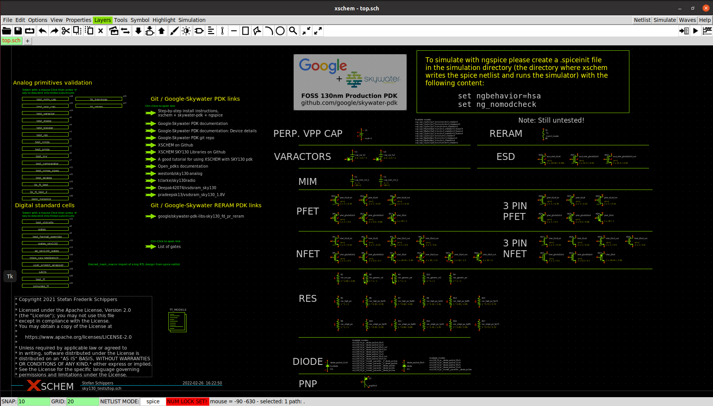

Slide 45
Ngspice
Ngspice is a general-purpose circuit simulation program for nonlinear and linear analyses.
It offers a variety of source types including DC, sine-wave, and pulse.
Analysis modes include DC analysis, AC analysis, and transient analysis
Circuit response is obtained by iteratively solving Kirchhoff’s Laws for the circuit

Slide 46
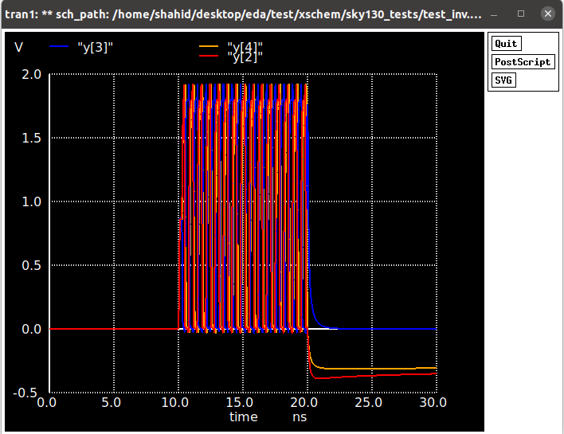
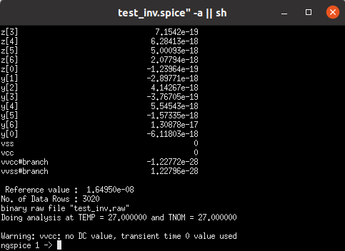

Slide 47
Magic VLSI
Magic is an Open Source tools for custom layout designs
It is more than just a color painting tool and also understands quite a bit about the nature of circuits
Tool uses simplified design rules and circuit structures for laying out devices
It also extracts the Netlist from layout for LVS

Slide 48
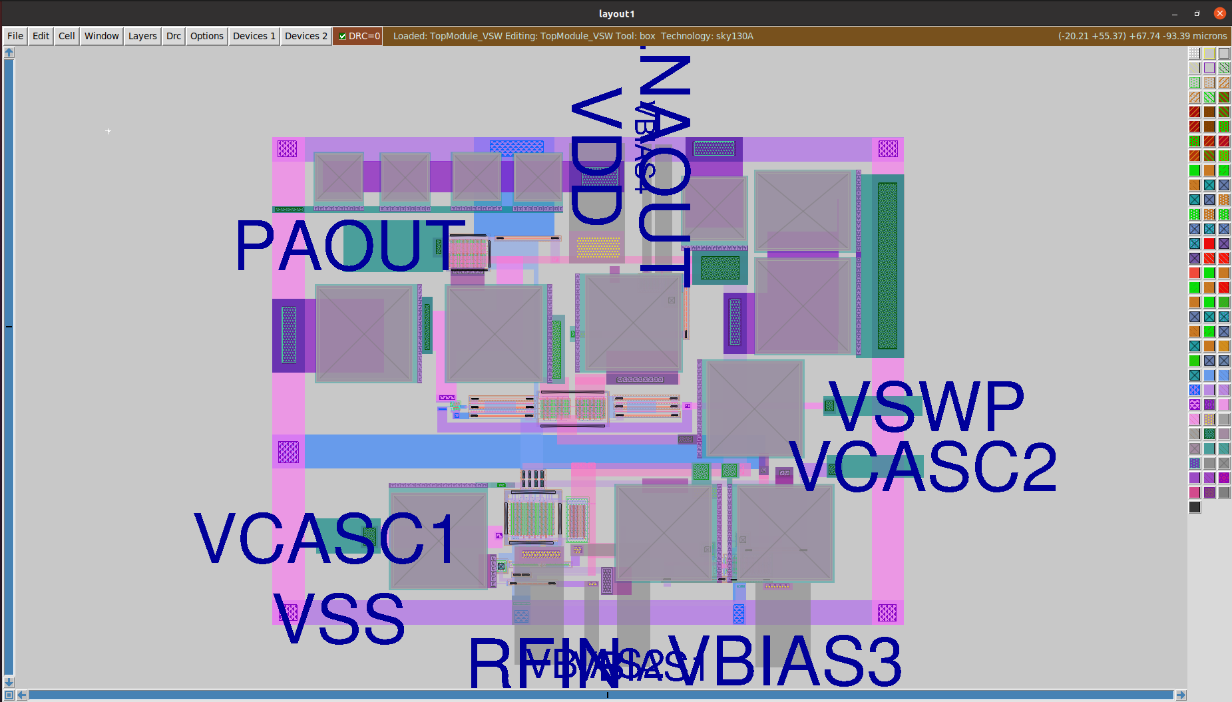

Slide 49
Netgen
LVS using Netgen Tool
Netgen is a tool for comparing netlist generated from Schematic and Layout
It ensures the geometry of laid out circuit matches the expected Schematic circuit

Slide 50
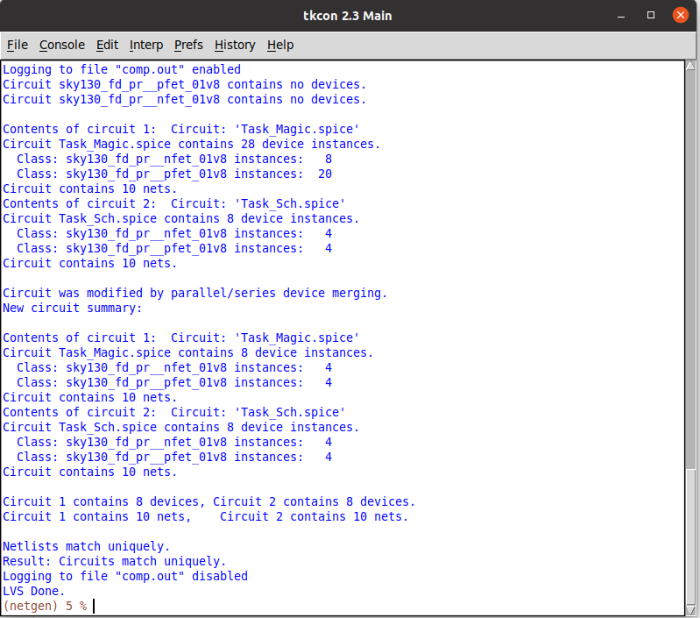

Slide 51
Klayout
Klayout is also a layout viewer.
It can be used to view mag, def and gds files.
It has a more modern user interface.
It has DRC and LVS functionality but is not yet completely supported for sky130PDK

Slide 52
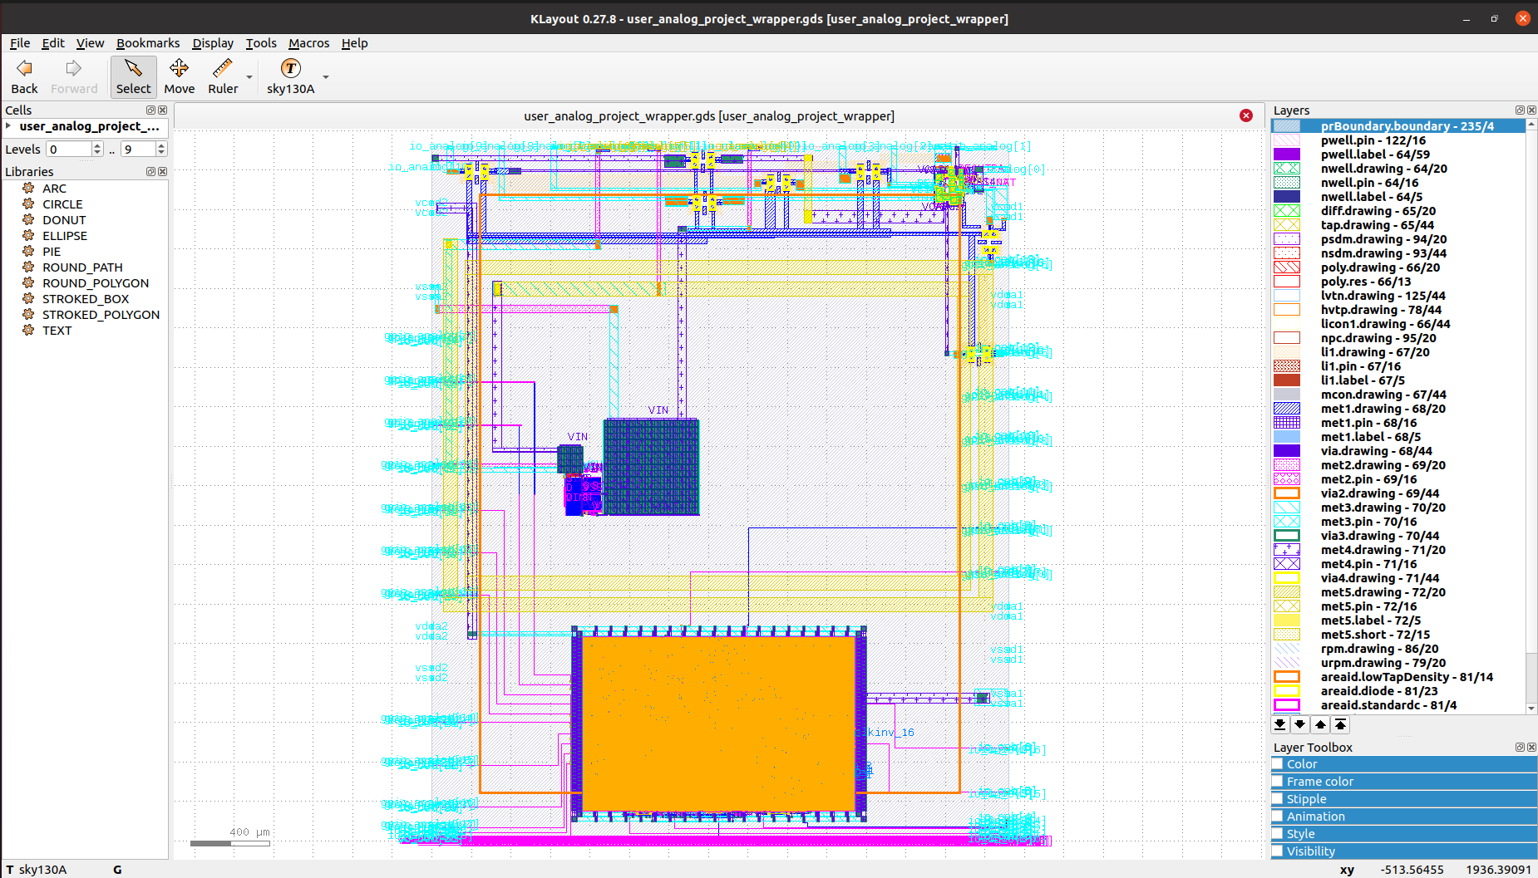

Slide 53
Openlane
Open lane is a complete RTL to GDS compiler tool.
It uses Icarus Verilog for RTL simulations, yosys for synthesis, open lane for backend design.
Efabless provides and maintains this tool for skywater PDK.

Slide 54
Thanks for Your Attention!

